Slide 1
PSCS222-BLOCKCHAIN FOR THE GOVERNMENT TO BE ABLE TO TRACK THE ORIGIN AND DESTINATION OF PRODUCT
PIP2001 Capstone Project
VIVA-VOCE
Batch Number: CBC-04
Roll Number | Student Name
20211CBC0019 | M.RAVI SHANKAR PRASAD
20211CBC0060 | CHIGULLA NAGAPAVAN
20211CBC0017 | NAGESH S
20211CBC0034 | P.AKSHAY KUMAR
Under the Supervision of,
Ms. ARSHIYA LUBNA
Assistant Professor
School of Computer Science and Engineering
Presidency University
Name of the Program: COMPUTER SCIENCE AND ENGINEERING
Name of the HoD: DR. PRAVINTHA RAJA
Name of the Program Project Coordinator: SUMA GOWDA
Name of the School Project Coordinators: Dr. Sampath A K / Dr. Abdul Khadar A / Mr. Md Ziaur Rahman

Slide 2
Table of Contents
S.No Contents Pg.no
1. Introduction 4
2. Literature Review 5-9
3. Research Gaps Identified 10-12
4. Proposed Methodology 13-15
5. Objectives 16-17
6. System Design & Implementation 18-19
7. Timeline of Project 20
8. Outcomes / results Obtained 21-24
9. Conclusion 25
10. References 26
11. Publication Details 27

Slide 3
Introduction
Blockchain technology for tracking the origin and destination of products in government operations is a revolutionary way of making supply chains transparent, traceable, and efficient. Governments around the world are facing problems in monitoring the movement of goods, fighting counterfeit products, and ensuring compliance with regulations to gain consumer confidence. Traditional tracking systems lack real-time visibility, have errors, and require much manual intervention. With the decentralized, immutable, and transparent ledger system offered by blockchain technology, these problems can be handled in a much more robust way.

Slide 4
Literature Review
Blockchain technology, since its inception with cryptocurrencies, has shown tremendous promise in various sectors beyond finance, particularly in supply chain management and regulatory systems. Governments across the world are increasingly exploring blockchain’s potential to track the origin and destination of products, ensuring transparency, authenticity, and compliance throughout the supply chain. Blockchain’s fundamental features—decentralization, immutability, and transparency—make it uniquely suited to meet the challenges faced by government agencies in monitoring and regulating the movement of goods.[1]

Slide 5
For governments, the implementation of blockchain has many benefits by tracking product movements. Blockchain sets up a public, tamper-proof system enabling governments to inspect the authenticity at every stage. This is paramount in industries characterized by high possibilities of counterfeiters, such as pharmaceuticals drugs, where dangerous health effects characterize fake drugs. That is what blockchain technology does-it provides real-time origin validation of products. This, therefore, reduces fraud and gives confidence to the consumer that the products being served are safe and legitimate. When talking about food safety, traceability of tainted goods allows a response by any given authority to public health threats real-time. For example, when tainted food is detected, blockchain technology can trace its origin in the supply chain to identify where it was contaminated and prevent its distribution further.[2]

Slide 6
Blockchains also facilitate easier regulatory compliance for governments besides improving traceability and fraud prevention. This is made possible through smart contracts—the self-executing contracts with the terms of an agreement directly written into lines of code. Thus, governments are able to check whether all products comply with requirements before they hit the market or cross borders, thereby eliminating the manual checks and paperwork involved in clearing customs, cutting down on errors, and consequently delays. Moreover, blockchain is decentralized; therefore, a government can be able to ensure that all the relevant parties in the supply chain-from customs officers to regulatory bodies to consumers-have secure and real-time access to data for ascertaining the authenticity of commodities.[3]

Slide 7
1.Blockchain Technology and Transparency:
There are several studies that indicate blockchain technology increases transparency in supply chains. For instance, it has been proven that blockchain's decentralized and immutable nature ensures that every transaction is logged and is visible to the authorized stakeholders. This transparency also minimizes cases of corruption and fraud in any governmental process. A case of Walmart's food safety tracking through the use of blockchain indicated that blockchain minimized time taken to trace the origin of a product to 2.2 seconds instead of 7 days (IBM Food Trust, 2019). This might transform the functioning of government regulation systems.

Slide 8
2. Smart Contracts for Automated Regulation:
Smart contracts, an integral part of blockchain technology, have been explored as tools to automate compliance and reporting. Research by Christidis and Devetsikiotis (2016) explained how smart contracts could enforce regulations automatically, such as ensuring that imported goods meet quality standards before clearance. Governments can benefit from reduced manual intervention and faster enforcement of rules.
3. Anti-Counterfeiting Systems in Supply Chain:
A blockchain-based tracking system ensures the authenticity of products since it provides digital records that cannot be altered and enables governments to check the originality and the difference in time. This application is very useful for drugs, luxury commodities, and electronic products.

Slide 9
RESEARCH GAPS IDENTIFIED
Despite the great strides made in blockchain technology and its application in supply chain management, there are still several research gaps in the existing methods that hinder the effective implementation of blockchain for tracking the origin and destination of products, especially for governmental use.
Interoperability Challenges:
Current blockchain solutions are often not interoperable between different systems and platforms. Governments typically operate across multiple jurisdictions with heterogeneous supply chain systems, and current methods do not adequately address seamless integration of such heterogeneous systems.

Slide 10
2. Data Privacy and Security:
Although blockchain is inherently transparent and immutable, balancing data transparency with privacy is difficult. Most methods currently in place do not offer robust privacy-preserving mechanisms that are essential to protect sensitive information in government supply chains.
3. High Deployment and Maintenance Costs:
The financial implications of the cost of setting up and maintaining blockchain infrastructure are usually quite high. Most of the current solutions are not cost-friendly; hence adoption becomes challenging, particularly for developing nations' governments.

Slide 11
4. Traceability of Complex Supply Chains:
A complex supply chain may consist of multiple tiers of suppliers. It becomes quite challenging to have complete traceability in such chains. Most existing blockchain solutions do not offer sufficient granular visibility across all the layers of a supply chain.
5. Stakeholder Adoption and Incentives:
Effective implementation requires all stakeholders, but current methods do not sufficiently incentivize participation or tackle the resistance to the adoption of new technologies.

Slide 12
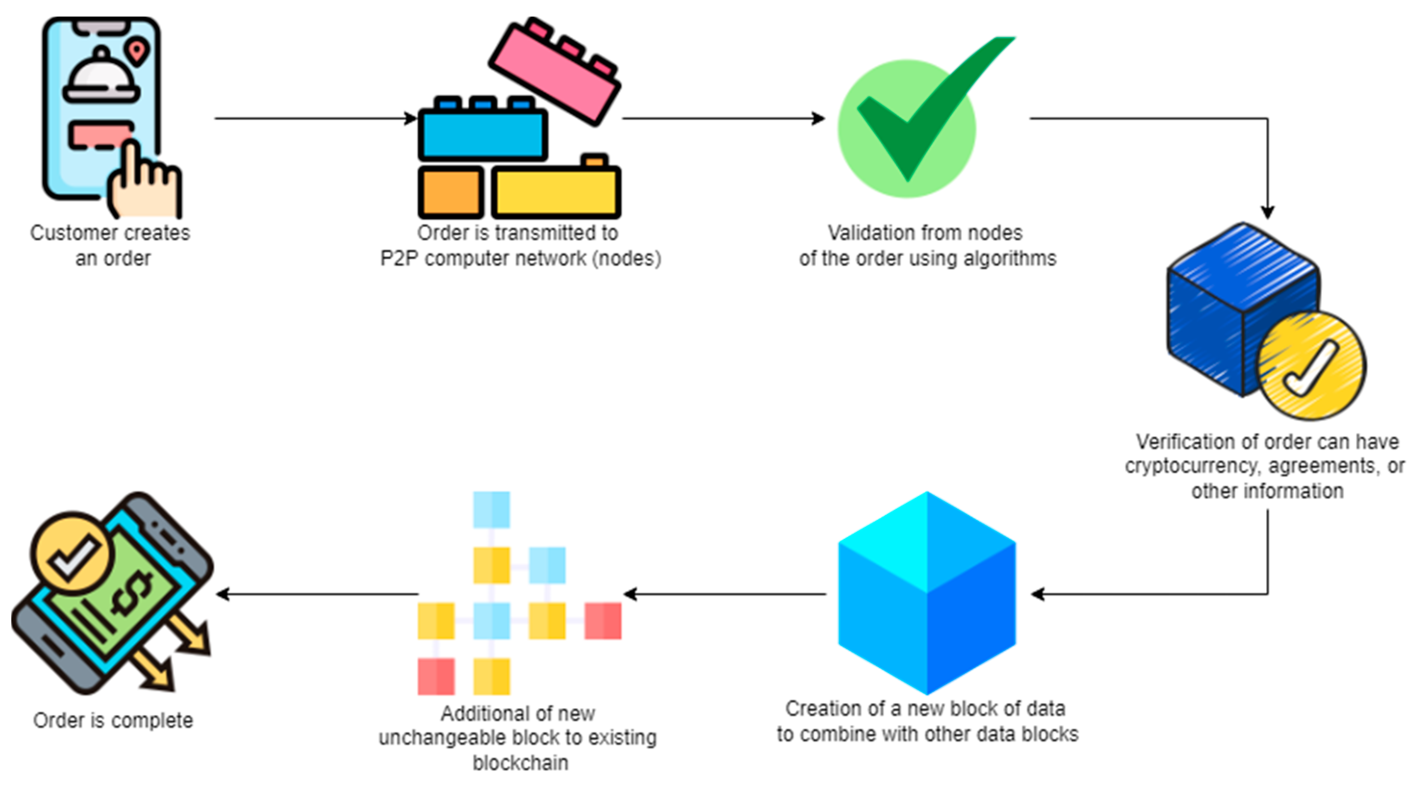
Proposed Methodology
The proposed method leverages blockchain technology to create a decentralized, transparent, and tamper-proof system for tracking the origin and destination of products. By using smart contracts and distributed ledger technology, the system ensures real-time updates and secure record-keeping across all stakeholders in the supply chain

Slide 13
1. Data Collection and Onboarding:
All the stakeholders in the supply chain, including manufacturers, suppliers, distributors, retailers, and regulatory bodies, will be registered and authenticated on the blockchain network. IoT devices, RFID tags, and QR codes will be deployed for real-time data collection and integration.
2. Data Privacy and Security:
Advanced cryptographic techniques, such as zero-knowledge proofs (ZKPs), will be applied to protect sensitive information while allowing transparency. The mechanisms of access control will ensure that only authorized entities can view certain data.

Slide 14
3. Product Lifecycle Tracking:
Every product will carry a unique digital identity that can be associated with its source and destination information. The blockchain will contain immutable entries about the lifetime of the product, such as manufacturing information, transportation routes, storage conditions, and final delivery.
4. Scalability and Performance Optimization:
Sidechains or sharding techniques will be applied to manage a high transaction load with no performance compromise. The techniques will allow the system to scale as the network expands.

Slide 15
Objectives
The objectives of the project are to develop a blockchain-based system that enables the government to accurately track the origin and destination of products in real time.
It aims to enhance supply chain transparency by providing an immutable and secure record of product movements, ensuring compliance with regulations
Additionally, it seeks to streamline communication between stakeholders, improve data accuracy, and facilitate faster, more informed decision-making in government oversight.

Slide 16
Data Security Strengthening:
Advanced methods of cryptography will be applied towards the safety of data in storage on the blockchain. Techniques for hash functions, digital signatures, and zero knowledge proofs will protect sensitive information while concurrently allowing authorized users to be kept in the picture. Data breaches and unauthorized tampering would be impossible.
2. Scalability for Nationwide Deployment:
The blockchain solution shall use sharding or sidechains to handle a growing number of transactions and participants. Therefore, the system will be very fast and reliable as it is scaled up into nationwide or global supply chains.

Slide 17
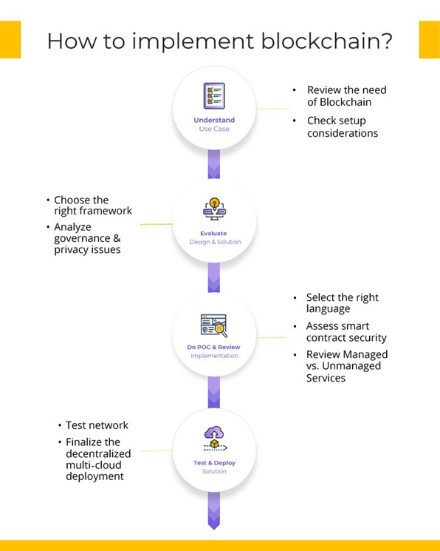
System Design and Implementation
.

Slide 18
Layered Structure:
Data Layer: Stores immutable records of transactions, product metadata, and timestamps.
Application Layer: Interfaces for stakeholders including dashboards, APIs, and analytics tools.
Consensus Layer: Validates transactions using efficient consensus mechanisms like Proof-of Authority (PoA) or Raft.
Network Layer: Ensures connectivity among nodes and data exchange between stakeholders.

Slide 19
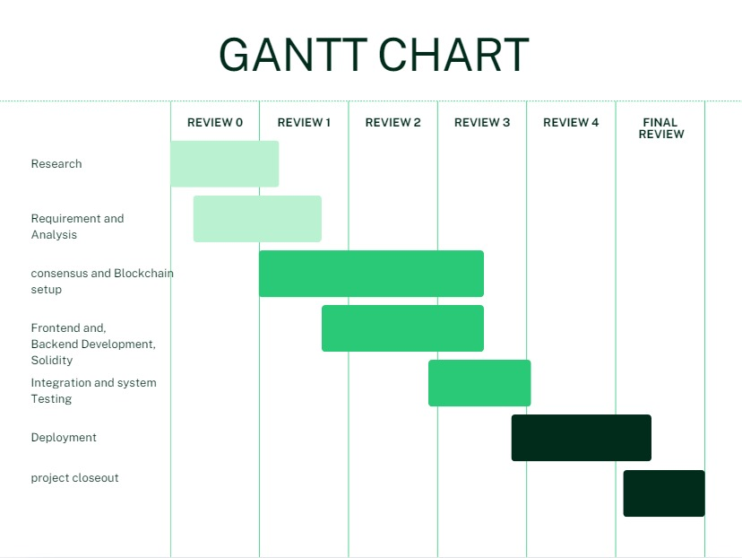
Timeline of Project
.

Slide 20
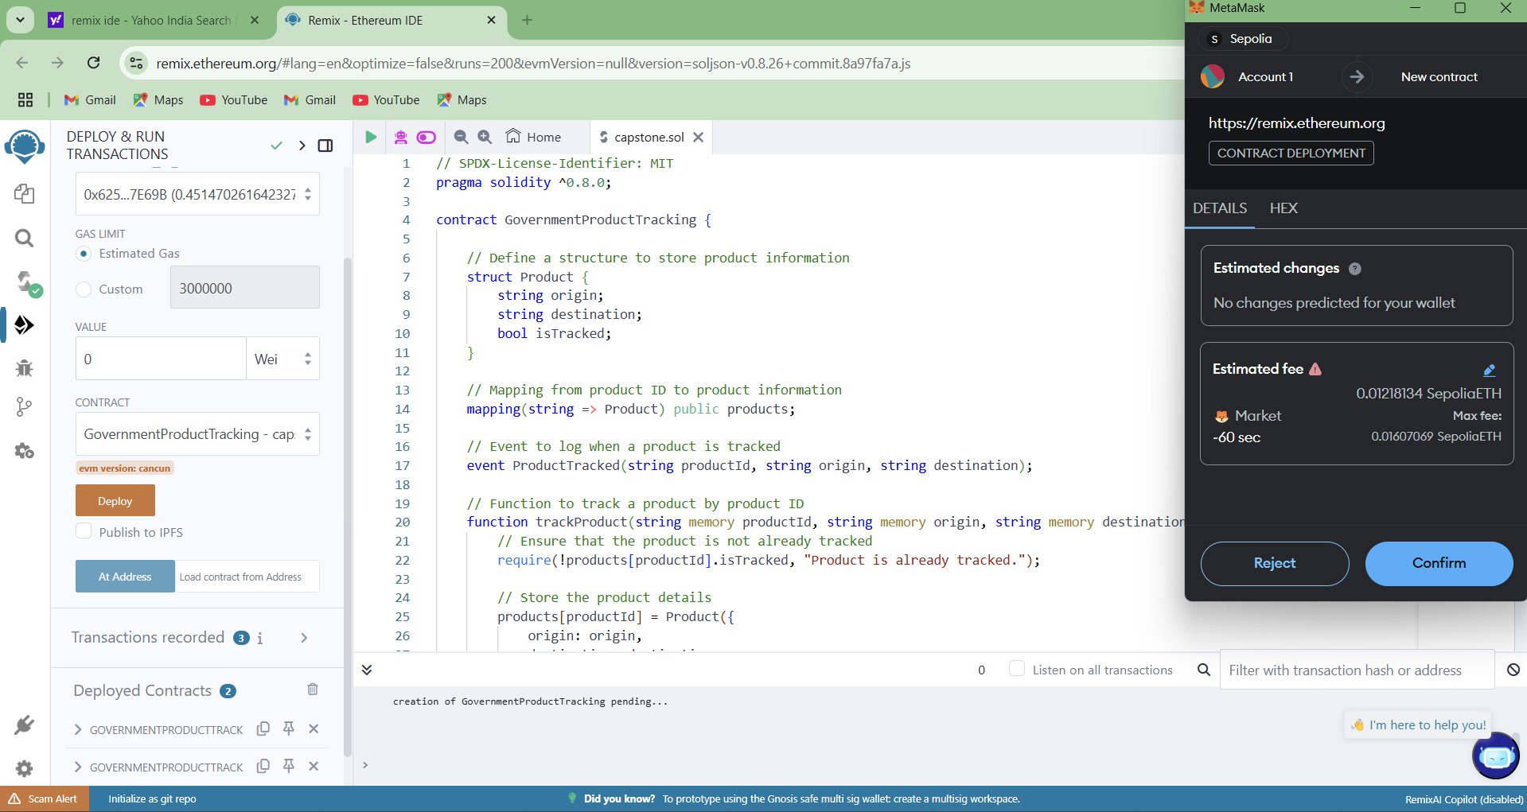
Outcomes/Results Obtained

Slide 21
Using remix ide platform we need to a run solidity code for blockchain for the government to be able to track the origin and destination of product, To deploy a backend solidity code we need to connect to meta mask wallet and it should be there transaction fees in the wallet to deploy the code ,After deploying the code it will generate the ABI and Contract address
After deploying code and connecting to the meta mask we get the transaction confirmation from the meta mask wallet, after we will get the all transaction details in remix ide platform

Slide 22
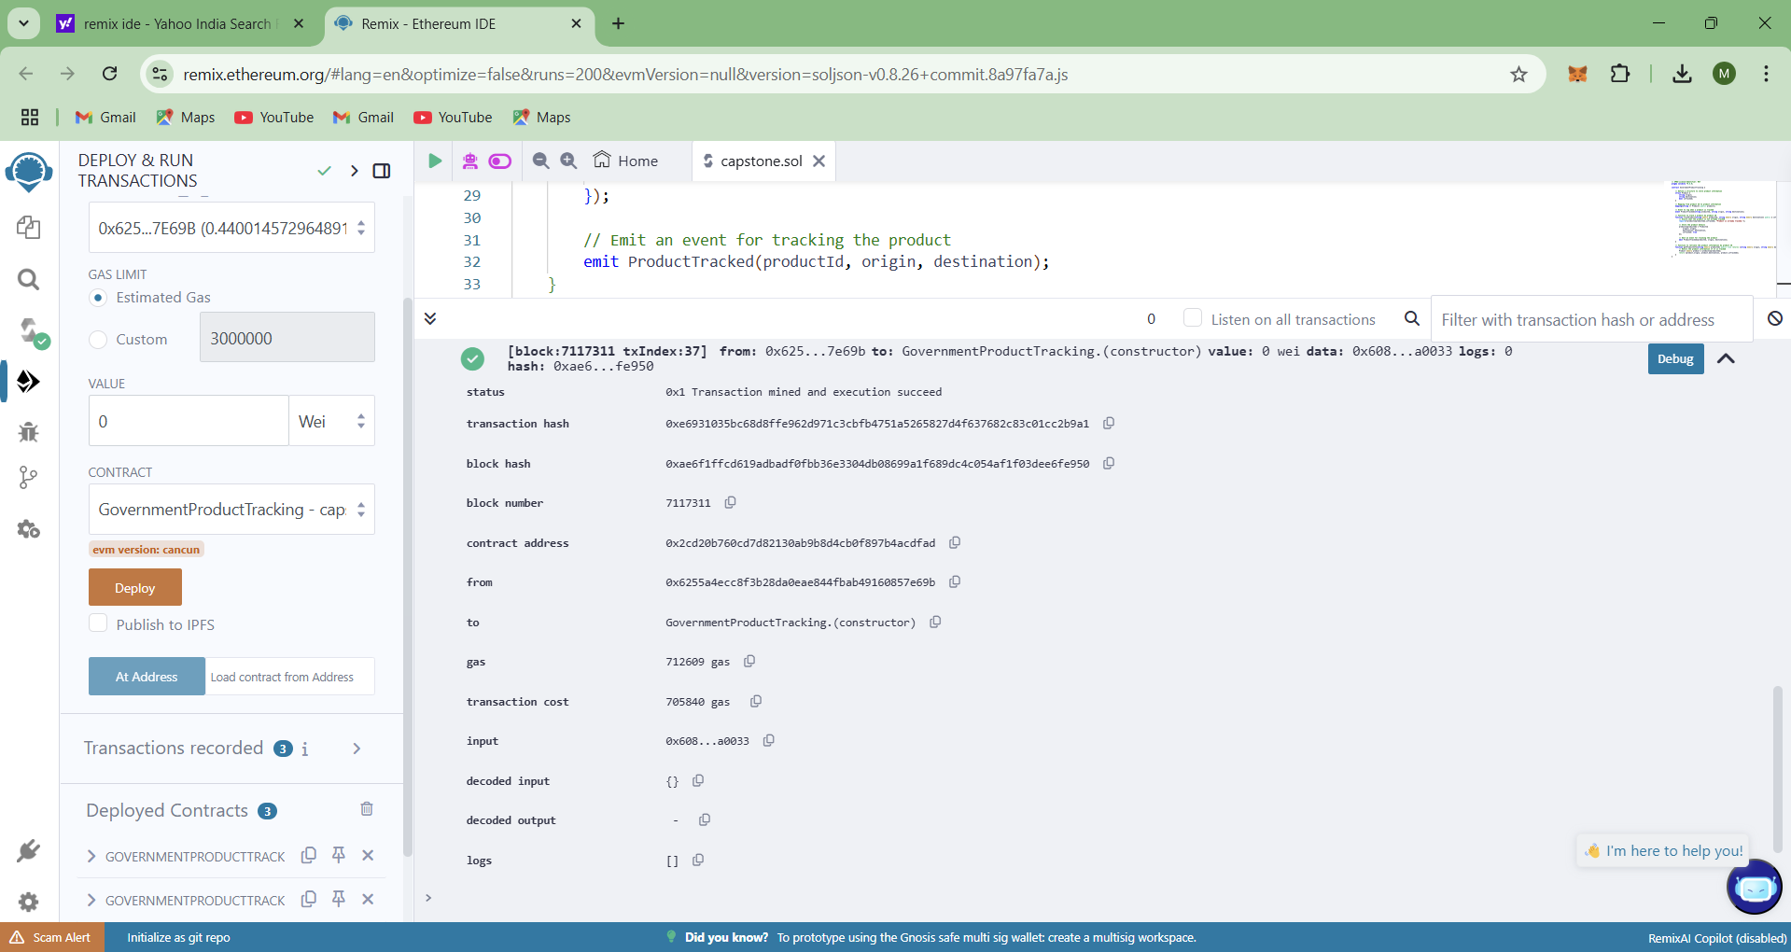

Slide 23
It will displays the all the transaction details in the remix ide platform
The blockchain system successfully recorded all stages of the product lifecycle, from raw material sourcing to final delivery. Each transaction was timestamped and immutable, ensuring complete traceability. Stakeholders, including government agencies, gained real-time visibility into the supply chain.

Slide 24
Conclusion
A blockchain-based system for tracing the origin and destination of products provides a revolutionary approach for governments to improve the transparency, traceability, and efficiency of the supply chain. With the immutability ledger and smart contract functionality of blockchain, the system helps overcome crucial problems such as fraud, counterfeit goods, and compliance with regulatory issues. Real-time monitoring and data sharing allows the stakeholders such as manufacturers, logistics providers, and government agencies to work effectively yet in trust and accountability. It also provides a chance of accuracy and on time update from the IoT devices and digital identifiers which increases the supply chain reliability overall.

Slide 25
References
[1]. Saberi, S., Kouhizadeh, M., Sarkis, J., & Shen, L. (2019). Blockchain Technology and Its Relationships to Sustainable Supply Chain Management. International Journal of Production Research, 57(7), 2117-2135. DOI: 10.1080/00207543.2018.1533261
[2]. Tian, F. (2017). A Supply Chain Traceability System for Food Safety Based on HACCP, Blockchain & Internet of Things. Proceedings of the 14th International Conference on Services Systems and Services Management, 1-6. DOI: 10.1109/ICSSSM.2017.7996119
[3]. Wang, Y., Han, J. H., & Beynon-Davies, P. (2019). Understanding Blockchain Technology for Future Supply Chains: A Systematic Literature Review and Research Agenda. Supply Chain Management: An International Journal, 24(1), 62-84. DOI: 10.1108/SCM-03-2018-0148
[4]. Zhang, Y., & Wen, J. (2017). The IoT-Enabled Blockchain for Trustworthy Management of Logistics and Supply Chain. Proceedings of the 2017 International Conference on Smart Blockchain, 10-12. DOI: 10.1007/978-3-319-63688-7_7

Slide 26
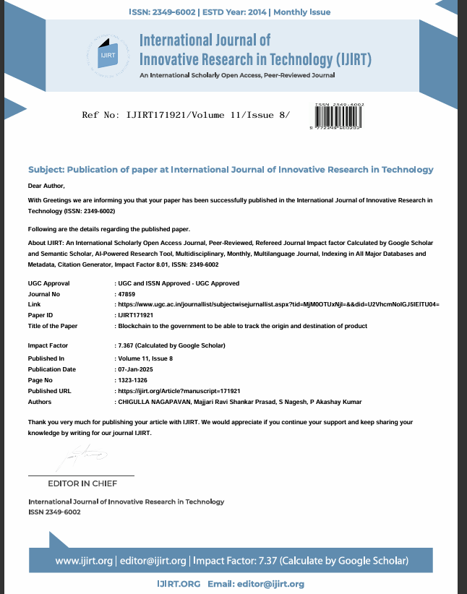
Publication Details
.

Slide 27


